Slide 1
Universal Design of Case Management Support Services for College Students on the Autism Spectrum
Les Gallo-Silver, LCSW-R
Associate Professor of Health Sciences
Regina Varin-Mignano, PhD, LCSW-R
Project Investigator-The Wellness Center/LaGuardia ASSIST

Slide 2
Neuro-Diversity
People with Autism Spectrum Disorder have brains that are structurally different than Neuro-typical people.
These differences have been documented by brain imagining studies
We are not currently able to determine what these brain differences mean nor are the brain images of people with ASD the same as each other’s.
Genetic studies suggest that there are subtle differences in the DNA of people with ASD but these differences are not consistent.
People with ASD are at times able to excel in specific areas of functioning beyond the abilities of Neuro-typical people.
Donvan & Zucker, 2016; Silberman, 2015; Grandin & Panek, 2013

Slide 3
The Social Challenge of College
When individuals with AS arrive at college they tend to isolate themselves due to sensory overload-initiation issues
They may initially make some attempt to talk and socialize with others but may be excluded due to their social awkwardness or odd repetitive sensory-motor behaviors.
Small group assignments cause anxiety and obstructive behaviors
Experiential learning causes emotional outbursts and anger
Social avoidance becomes a reinforced behavior
Student my leave class to end aversive social interactions.
Gallo-Silver & Varin-Mignano, 2016

Slide 4
Academic & Social Student Integration for Success Team(ASSIST)
ASSIST Actively promotes a campus wide environment of inclusion and understanding of neuro-diverse students and seeks to enhance access to services for students on the autism spectrum that
Provide successful educational opportunities
Increase self-knowledge in the areas of
executive functioning
self-regulation
social interaction
self-advocacy
career preparation
Gallo-Silver & Varin-Mignano, 2016

Slide 5
ASSIST Program Components
Psychosocial support and peer coaching services are organized using universal design
For people on the Autism Spectrum this requires a mixture of
positive psychology
motivational interviewing
cognitive-behavioral therapies
professional and peer counselor interventions
Gallo-Silver & Varin-Mignano, 2016

Slide 6
Typical Accommodations
Assistive Technology
Additional time on examinations
Additional time on assignments
Changes in assignments
Alternative examination locations-Distraction free environment
Tutoring services
Note Takers
Audio-Taping class lectures (to be played back in smaller bits)
Permission to leave class
Gallo-Silver & Varin-Mignano, 2016

Slide 7
Peer Mentors: Coaching as Accommodation
Helps to interpret a social interaction that occurred between faculty and/or student that confuses or upsets the student with ASD
Reviews organizational issues, including internal and external obstacles to complying with a daily schedule or completion of a homework assignment
Serves as stress modulators by helping student during class
Seeks to control help seeking behaviors
Promotes personal responsibility by providing another person who reality tests of whether social tasks have been attempted
Gallo-Silver & Varin-Mignano, 2016

Slide 8
Concepts of Positive Psychology
Positive Emotions can generate therapeutic change.
Positive Psychology Theory intersects with Strength-Centered Therapy because both share a focus on strengths.
The metaphor they share is calling strengths character traits.
Character traits are either existing or desired.
Each person has a signature trait.
Traits can be “broadened and built upon”.
Fitzpatrick & Stalikas 2008,Wong 2006a, Seligman et al 2006, Lopez & Kerr 2006, Fredrickson 2001

Slide 9
Core Traits (strengths) Fredrickson 2001; Dunn & Dougherty 2005; Fredrickson & Levenson 1998; Folkman 1997
Altruism
Contentment
Courage
Creativity
Forgiveness
Hopefulness
Inquisitiveness
Capacity to feel Joy
Capacity to Love
Capacity to be Loved
Perseverance
Pride
Resilience
Sensory Pleasure
Tenacity
Wisdom

Slide 10
Elements of Positive Psychology
Explicitizing = Identifying character traits (strengths) using reframing.
Envisioning = Identifying the traits the person wants to develop-desired traits and how to use existing traits.
Empowering = The use of desired traits (strengths).
Evolving = Encouraging continued autonomous development.
Wong, 2006a; Wong, 2006b

Slide 11
Concepts of Motivational Interviewing
RULE
R- Resist the “righting reflex”, not trying to “fix” the student
U- Understand the student’s motivation, motivation comes from within the student
L- Listen to your client, acceptance without agreement, understanding the student’s perspective
E- Empower your client, all change is self-directed and self-implemented
Rollnick et al, 2008; Moyers et al, 2007; DiClemente, 2003

Slide 12
Elements of Motivational Interviewing
Creating a Relationship-OARS
OARS
O- Open-ended questions
A- Affirmations
R- Reflection
S- Summarization
Focusing- establishing, cultivating and nurturing a sense of direction
Evoking- identifying student’s desire, ability, reasons and needs for change
Planning- creating a change strategy and enhancing commitment
Miller & Rollnick, 2011

Slide 13
Helpful Hints in Working with Students with ASD-1 (Varin-Mignano, 2016)
Use and interpret speech literally. Until you know the capabilities of the student
Avoid idioms and humor (e.g.., save your breath, jump the gun, second thoughts; most jokes have double meanings)
Remember that facial expressions and other social cues may not work.
Most individuals with ASD have difficulty reading facial expressions and interpreting "body language".
If the student does not seem to be learning a task, break it down into smaller steps or present the task in several ways (e.g., visually, verbally, physically).

Slide 14
Helpful Hints in Working with Students with ASD-2 (Varin-Mignano, 2016)
Avoid verbal overload. Be clear. Use shorter sentences if you perceive that the student does not fully understand you.
Prepare the student for all environmental and/or changes in routine. Use a written or visual schedule to prepare him for change.
Consistent treatment and expectations from everyone is vital.
Be aware that normal levels of auditory and visual input can be perceived by the student as too much or too little.
Consider environmental changes such as removing "visual clutter" from the room or seating changes if the student seems distracted or upset by his classroom environment.

Slide 15
Helpful Hints in Working with Students with ASD-3 (Varin-Mignano, 2016)
Interrupt perseverative communication by having the student write down the communication as this usually begins to calm down the student and stops the repetitive activity.
Assume nothing when assessing skills. Uneven skills development is a hallmark of ASD.
Explain at the beginning of the semester it will not always be possible to predict all the changes that might occur, so the student can be prepared for such an occurrence.
Make the environment predictable or routine. Try to keep tutors, note takers, and proctors, the same throughout the class Explain any necessary changes with as much advance notice as possible.⁯

Slide 16
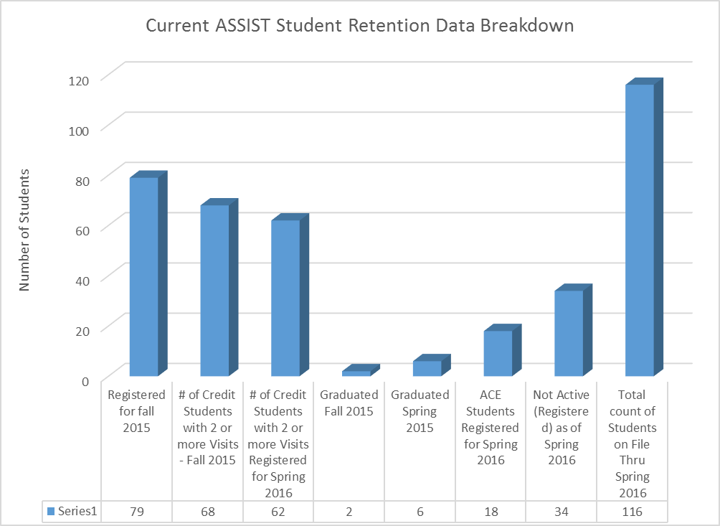

Slide 17
The Total number of students (unduplicated) for LaGuardia ASSIST Services:

Slide 18
The Total number of visits for LaGuardia ASSIST Services:

Slide 19
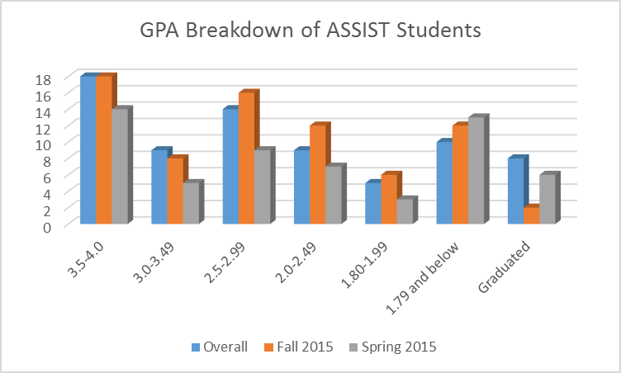

Slide 20
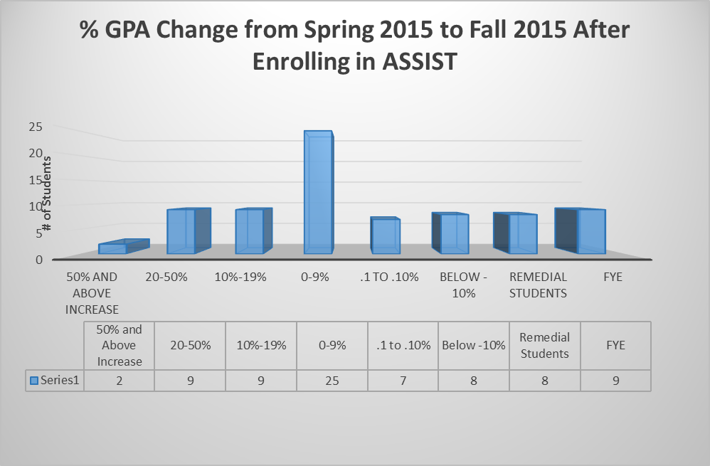

Slide 21
Summary
Neuro-diversity reframes ASD and diminishes stigma
College is both an opportunity for academic and social growth
ASSIST focuses on social anxiety management and social goals
The coaching function of peer mentors offers students with ASD an accommodation that can help academically and socially
The student identifies the specific concrete goal of counseling
The student identifies the steps needed to reach the selected goal
Positive Psychology diminishes focus on pathology
Motivational Interviewing is foundationally empowering
Gallo-Silver & Varin-Mignano, 2016

Slide 22
Contact Information
REGINA VARIN-MIGNANO, PhD, LCSW-R
Wellness Center
LaGuardia Community College
29-10 Thomson Ave, Suite C249
Long Island City, NY 11101
718-482-5443
Rvarin-mignano@lagcc.cuny.edu
PROF. LES GALLO-SILVER, LCSW-R
Department of Health Sciences
LaGuardia Community College
31-10 Thomson Ave, C252E
Long Island City, NY 11101
917-378-2662
Lgallo@lagcc.cuny.edu

