Slide 1
The Importance of Abolishing ATTITUDINAL Barriers Against Disability In Environments of Higher Education
Environmental access is not possible to really achieve, well, without first doing away with attitudinal barriers.
By: Julie Maury and Jessica De La Rosa

Slide 2
About Julie and Jessica:
Julie:
I am a Disability Studies Scholar.
I was a Disabled In Action Board Member.
I worked in an "Independent Living Center" as an information and referral specialist.
Currently working on advocacy around disability issues.
Jessica:
I'm involved in adaptive sports.
I am Ms. Wheelchair New York 2016.
I am a college graduate of John Jay who specialized in Security Management.
I am currently working on raising awareness around the rights of children with disabilities in schools.

Slide 3
What Evidence Is There, If Any, That Faculty Attitudes Actually Increase The Academic Success of Students With Disabilities?
There is evidence which demonstrates that positive faculty attitudes, towards students with disabilities, actually does increase the academic success of students with disabilities.
It is important to first understand that students with disabilities can encounter hardships in academic settings, as within general areas of life. This can result from an attitude of stigma from the majority of able-bodied society towards disability.
The Journal of Medical Humanities it was stated that: “[The term], “impairment” gained a fairly secure foothold [in society] for describing the divergence of certain bodies from their “normal” functioning, and “disability” became exclusively a term to describe the social disadvantage to which...society [sees] impairment (Hirschmann, Nancy, J., 2013).” These words demonstrate the negative connotations around divergent bodies.

Slide 4
Some Negative Faculty Attitudes Towards Students with Disabilities are Based in Unawareness:
It has been confirmed that some Professors of students with disabilities, in settings of Higher Education can hold a lack of proper knowledge around the issues of students with disabilities. In one qualitative research study, titled: The Chilly Climate for Students with Disabilities in Higher Education it was stated, in part, that: “There is...evidence that faculty seem uninformed about the nature of disability, oblivious to the needs of students with disabilities, or generally lacking in terms of understanding what it means to have a disability.”
“In fact, along with some students' general lack of preparedness for college and the absence of comprehensive support programs, negative attitudes of faculty are cited as a primary reason that students with disabilities fail at the postsecondary level."
Source: Beilke, J. R., & Yssel, N. (1999). The ChillyClimate for Students with Disabilities in Higher Education. College Student Journal, 33(3), 364.

Slide 5
There Is Great Value In Not Assuming One's Needs...Just Ask...
There was a qualitative study done about returning to college after having a Spinal Cord Injury resulting in paralysis. Three subjects, with spinal cord injuries, in this study that appeared in an issue of The American Journal of Occupational Therapy reported, on page 310, that: “...although they each had the capability of pushing their own wheelchairs, teachers...often assumed they could not and therefore did it for them. [This resulted in] feelings of loss of control and loss of dignity [for these three study subjects].” If a student, disabled or not, feels like they have been infantilized by faculty, this may not bode well for a students' future possibilities of academic success.

Slide 6
Faculty With Previous Positive Exposure to Disabilities Tend to React More Positively...
For example, in a Journal of Postsecondary Education and Disability article it was stated, in part: “Faculty who had a student or a friend with a psychiatric disability had more positive perceptions of working with students with psychiatric disabilities than faculty who did not have one of these experiences (Brockelman, K. F., 2011. Pg. 47).” This quote shows people something important-exposure to difference can help break down stigma around it. Also, this holds true for disabilities in general, not just those with mental health disabilities.
“Discomfort and fear of working with students who have mental illnesses were associated with making fewer accommodations and referrals (Brockelman, K. F., 2011. Pg. 44).” Fewer (or no) accommodations have been noted to have a direct effect on a students academic success: “Providing reasonable accommodations significantly increases the probability of success for [disabled]...students (Skinner, Michael E., 2007. Pg. 1).”

Slide 7

Developing A Wide Variety of Friends and Colleagues is Important...
Developing Friendships Can Help Combat Stigma...
Photo Description:
Six children and a Teacher sit around a table, in a classroom, working on a project. One of those children is in a wheelchair.

Slide 8
Faculty Attitudes, Towards Their Students' With Disabilities Can And Do Influence The Outcome Of Said Students' Level Of Academic Achievement:
Faculty attitudes towards disability can vary: “Faculty attitudes can range from viewing the student’s accommodation request as: an unfair advantage, something given only out of obligation, encouraged, or a right. Faculty attitudes can hinder, encourage, or enhance the student’s attempts to have appropriate accommodations implemented. The greater the communication between students with disabilities and faculty administration and the clearer the understanding of the nature of disability by all concerned, the more likely it will be that students with disabilities can maximize their educational potential and with ease (Graham, S. and English, R., 2001, Pg. 1).” Those quoted sentences let people know, and help reiterate to them, that faculty attitudes towards disability can and do differ and can be influential to students with disabilities.

Slide 9
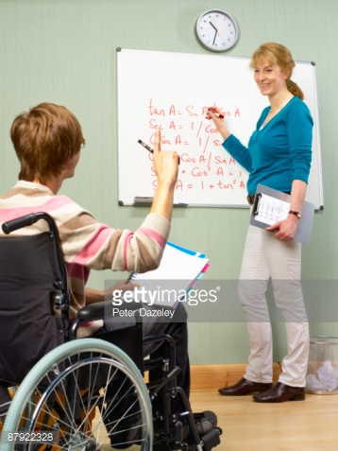
Positive Relationships In Academia Matter:
Don't Fear Asking Questions...
Photo Description:
A person in a wheelchair has their back facing the camera. This person is raising their hand. A woman Teacher stands in front of him and behind her there is a board with red letters. She smiles at him.

Slide 10
Effective Communication is a Key To Success:
An example of that is in The Journal of Deaf Studies and Deaf Education that stated, in part, the following about students who are Deaf and their ability to achieve academic success: “Success of deaf students in mainstream discourse situations is...highly dependent on their commitment to effective communication as well as the commitment of instructors and hearing peers (Lang, H. G., 2002. Page 275).” This quote shows Readers that when students who are Deaf participate in discussions, within mainstream classrooms, their positive academic performance is correlated to good communication. The communication must be effective from the students end of the conversation but also from the faculty members end as well. It stands to reason that lack of sign language ability, from the faculty member, would constitute a barrier in communication if that is the only way a Deaf student can communicate.

Slide 11
Students With Disabilities Should Be Taught Self-Advocacy Skills:
A book called: Preparing Students with Disabilities for College Success: A Practical Guide to Transition Planning by a Mr. Stan F. Shaw, Joseph W. Madaus, and Lyman L. Dukes, III states that: “...students with disabilities must be ready to immediately be active participants in the accommodations process (Shaw, et., al. P. 59).” It should be made clear that, although, positive faculty attitudes, towards students with disabilities do seem to correlate with increased academic achievement of those students—self-advocacy (of/by the students) plays an important role too. It is always important for students, with and without, disabilities to advocate for their own needs as to make their needs known. Otherwise, if a need for accommodation is not clearly stated to faculty, outright, it therefore cannot be assessed and resolved.

Slide 12
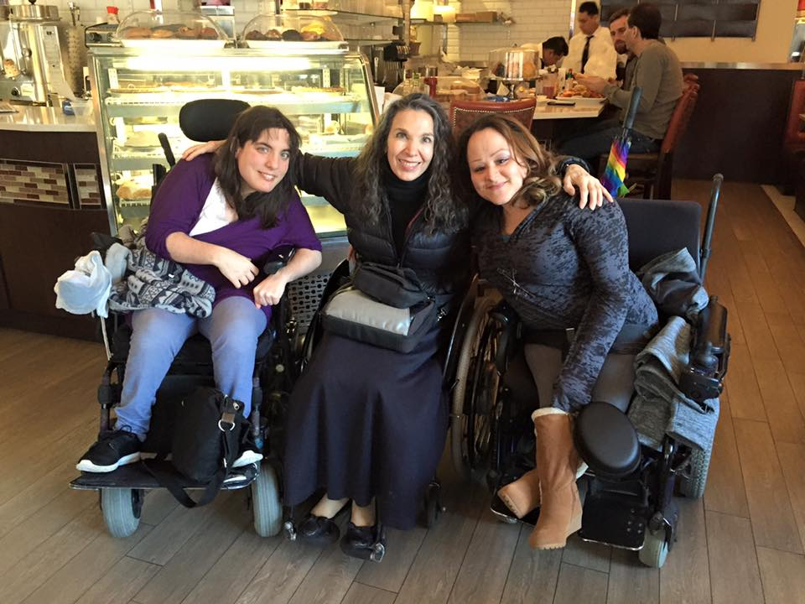
Mentors Are Important:
Three Friends:
Photo Description:
Three women in wheelchairs sit in front of a pastry stand, in a diner, with smiles on their faces looking at the camera. The woman in the middle has her arms around the girls to her side. The three women in the photos, from left to right, are Julie, Nadina, and Jessica.

Slide 13
Solutions:
Address issues/concerns directly and in a timely manner.
Do not assume what is possible. Always ask what is possible for a student to achieve.
Honor reasonable accommodations requests. It is better to not put your own judgements on them.
Encourage students to self advocate for what they need by giving them support to do so.
Learn about the value of the school's Student Support Services.
Engage in an active awareness about Disability Studies and Culture.
Look up books, films, etc. Dealing with Disability Studies and Culture.
Consider mandatory awareness/sensitivity trainings for school staff around disability issues. Make that a routine part of the school year.

