Slide 1
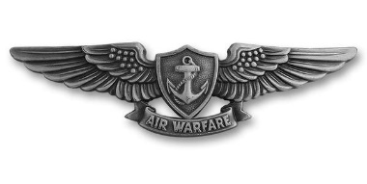
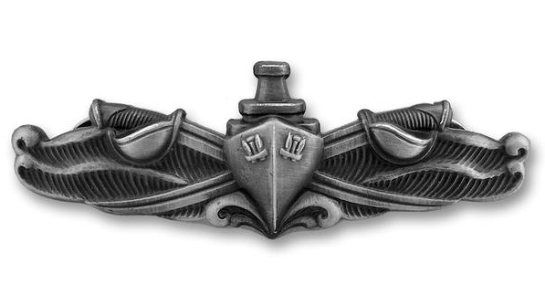
Invisible disabilities, stigma, and Student Veterans: Contextualizing the transition to higher education
Patrick J. Flink, PhD
US Navy Veteran
Hospital Corpsman 2nd Class

Slide 2
May, 2001

Slide 3
July, 2001

Slide 4
September 1st, 2001

Slide 5
September 23rd, 2001

Slide 6
September 23rd, 2001-
January 23rd, 2007

Slide 7
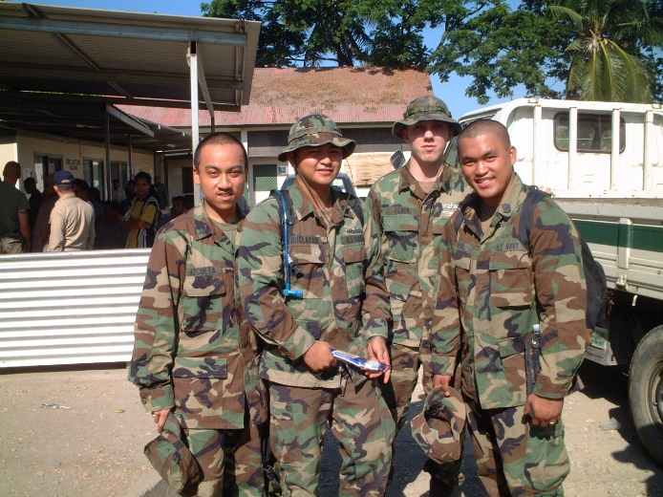
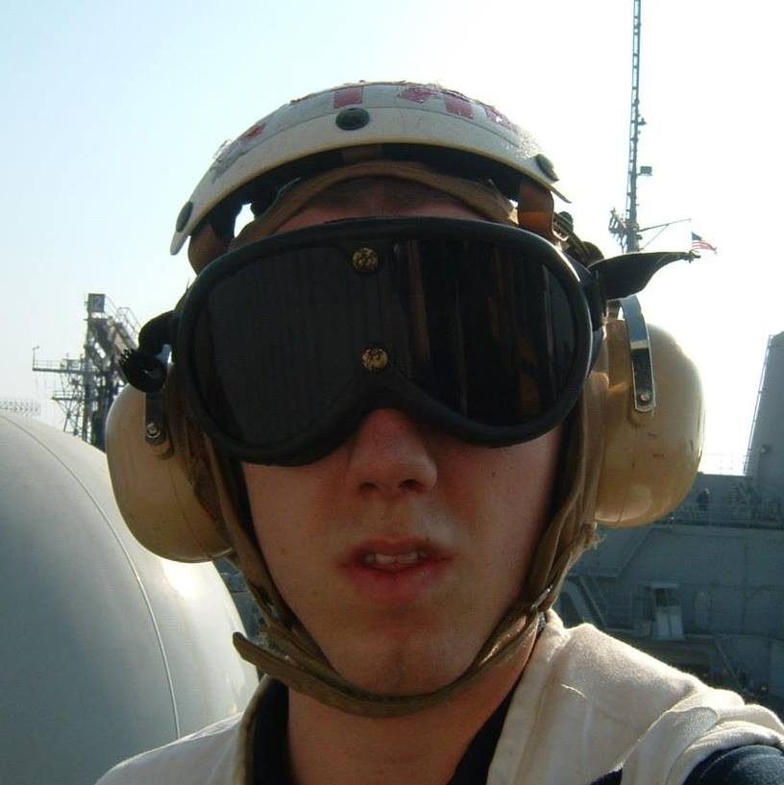
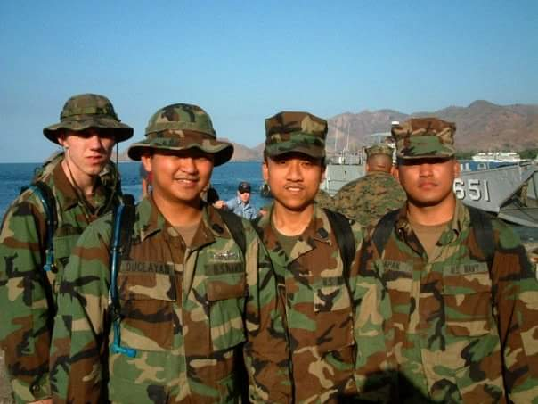
My Personal Experience

Slide 8
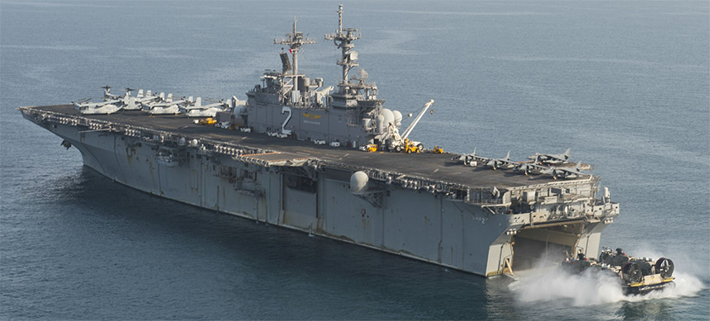
USS Essex (LHD-2)

Slide 9
Ship’s Rotation: 1.5 Months in Port / 1.5 Months Out to Sea for 2 years

Slide 10
Daily Ship Life in Schedules
12 on / 12 off
6 on / 6 off
18 on / 6 off
24 on (Duty / Field Deployment / Military Operation)
On call at any time, for drills or real evolutions such as:
Man Overboard / General Quarters / Department Drills or Exercises

Slide 11
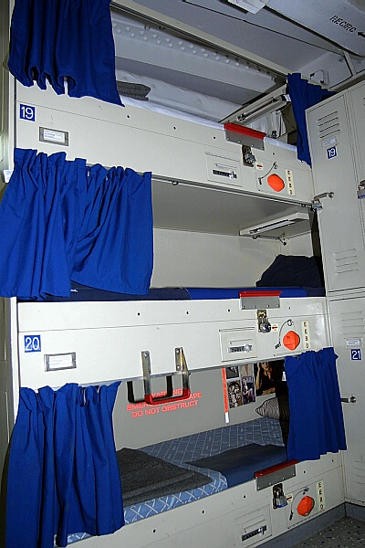
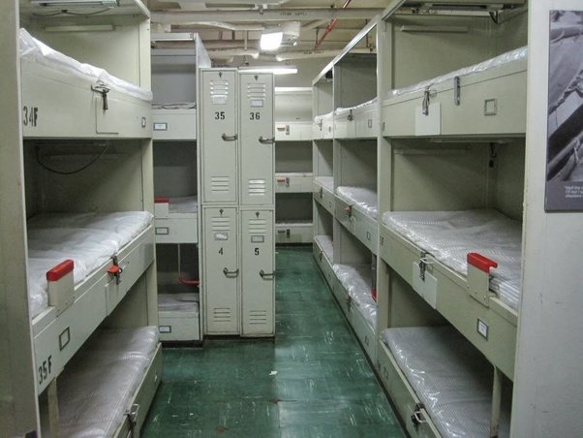
Life on a Naval Ship: Berthing

Slide 12
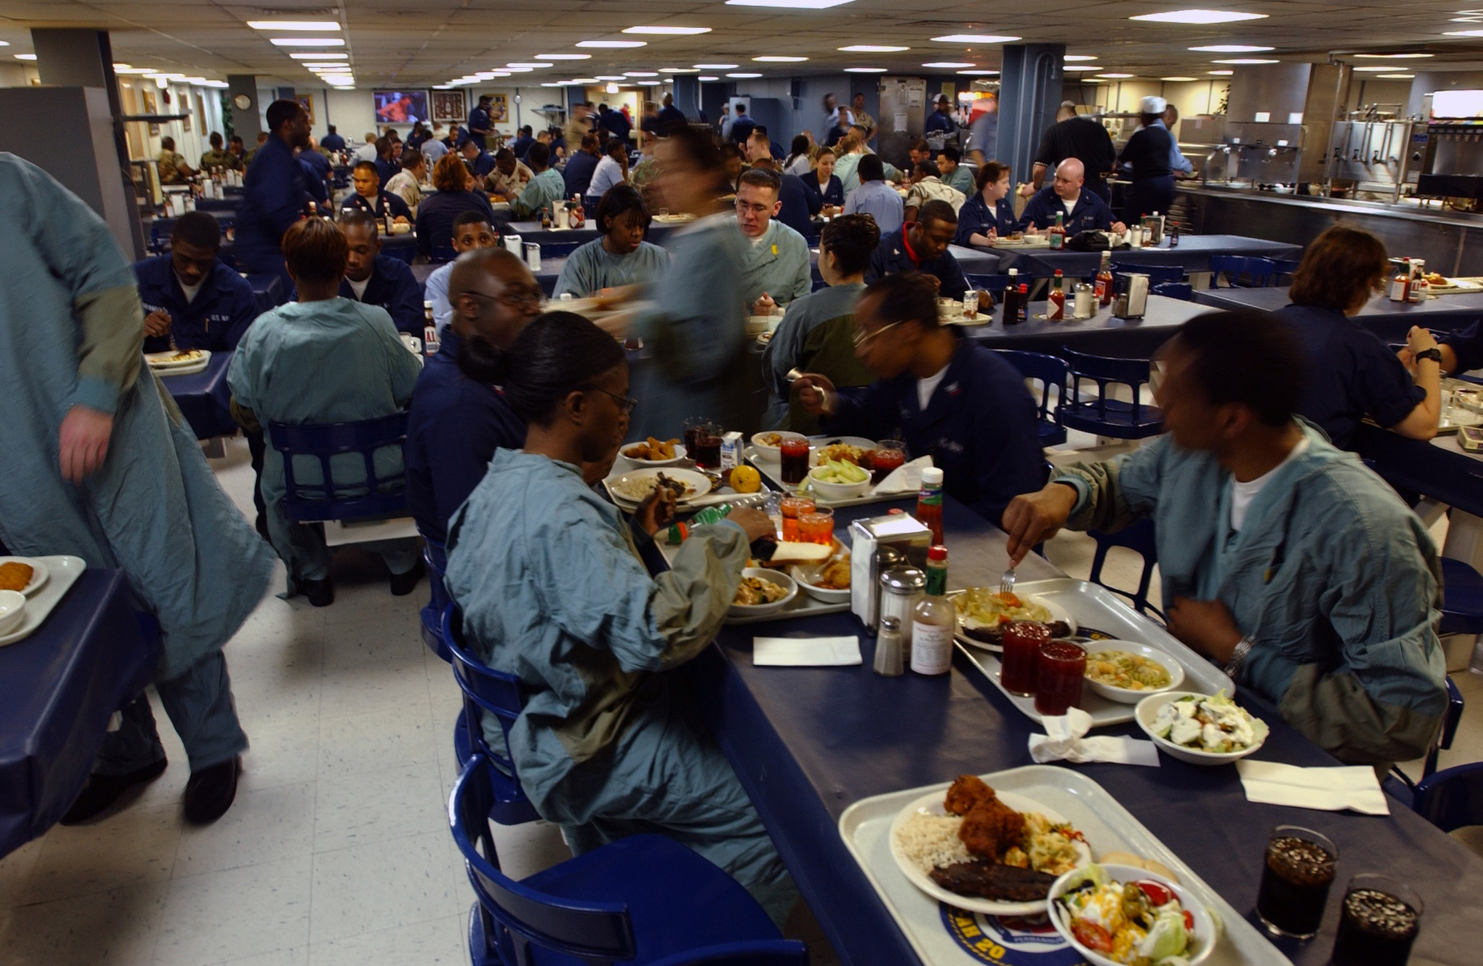
Life on a Naval Ship: The Galley

Slide 13
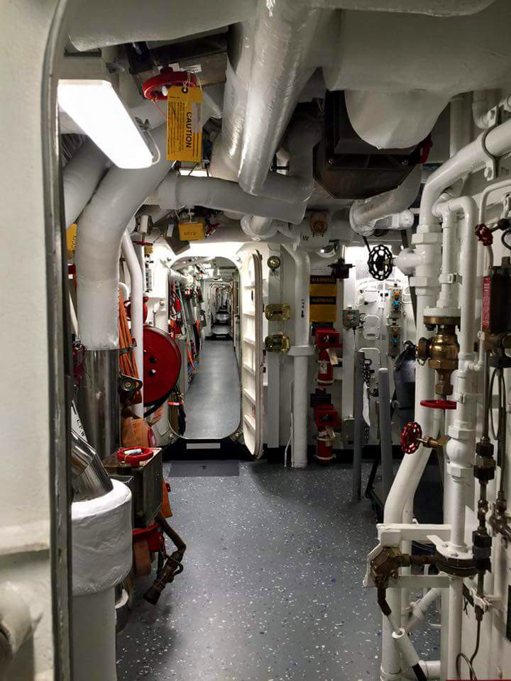
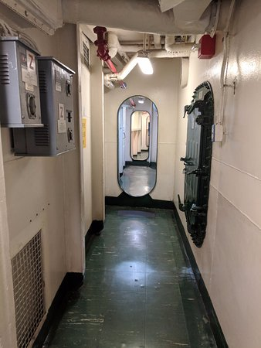
Life on a Naval Ship: Passageways

Slide 14
Objectives:
Explore how the transition to being a college student as a civilian is challenging for military veterans due to the stigmatization of invisible disabilities through the context of:
Military life and values
Invisible disabilities
Stigmatization
Transition Experiences

Slide 15
Why?
Currently, 800,000 veterans are attending college
Community colleges enroll the highest number of veterans
Pursuing education after military life can help ease the transition into the civilian world
Some military skillsets don’t transfer into the civilian world
Some veterans need to reskill in order to lead successful post-military lives
Veterans deserve an opportunity for a successful transition back into civilian life

Slide 16
What comes to mind when:
You think of the military
You think of servicemen and servicewomen
You think of PTSD
You think of injured and/or disabled servicemen and servicewomen

Slide 17
Contextualizing Military Life

Slide 18
Contextualizing Military Life
Structure:
Daily routines, jobs, exercising, expectations, regular pay and benefits
Order:
Uniforms, organization, standard operating procedures (for everything!)
Discipline:
Clearly defined chain of command, rules of conduct, respect seniority / authority

Slide 19
Transitioning to Civilian Life
Uncertainty:
Pay, work, and relationships are not guaranteed
Disorder:
General public: doesn’t understand or may not sympathize
Lack of Discipline:
Public doesn’t demonstrate uniform standards of discipline, respect, nor values

Slide 20
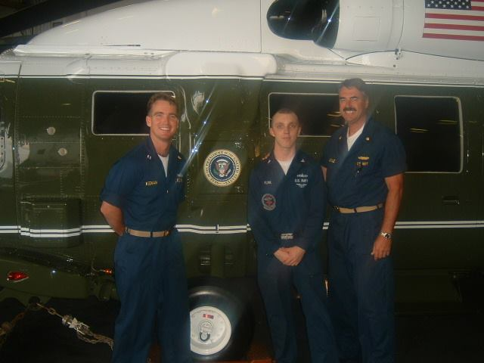
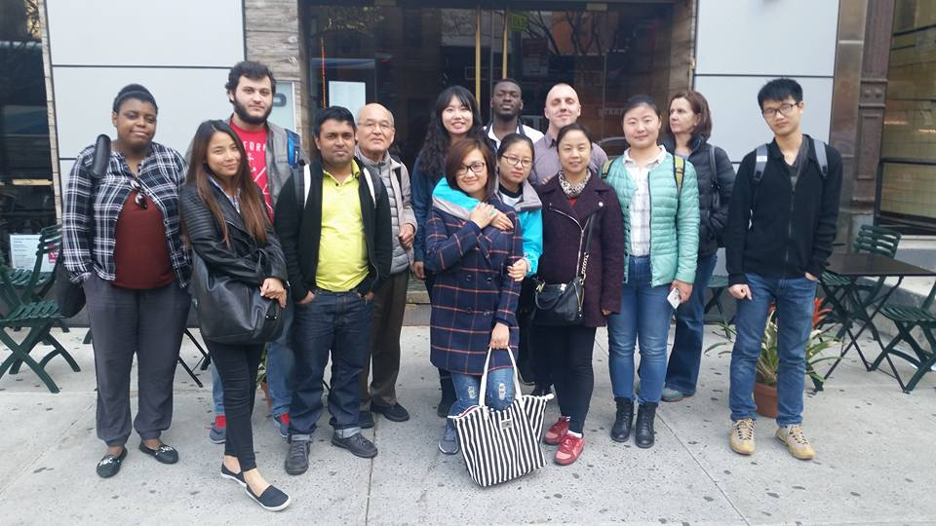
When Military Values Are Misunderstood
A Personal Example

Slide 21
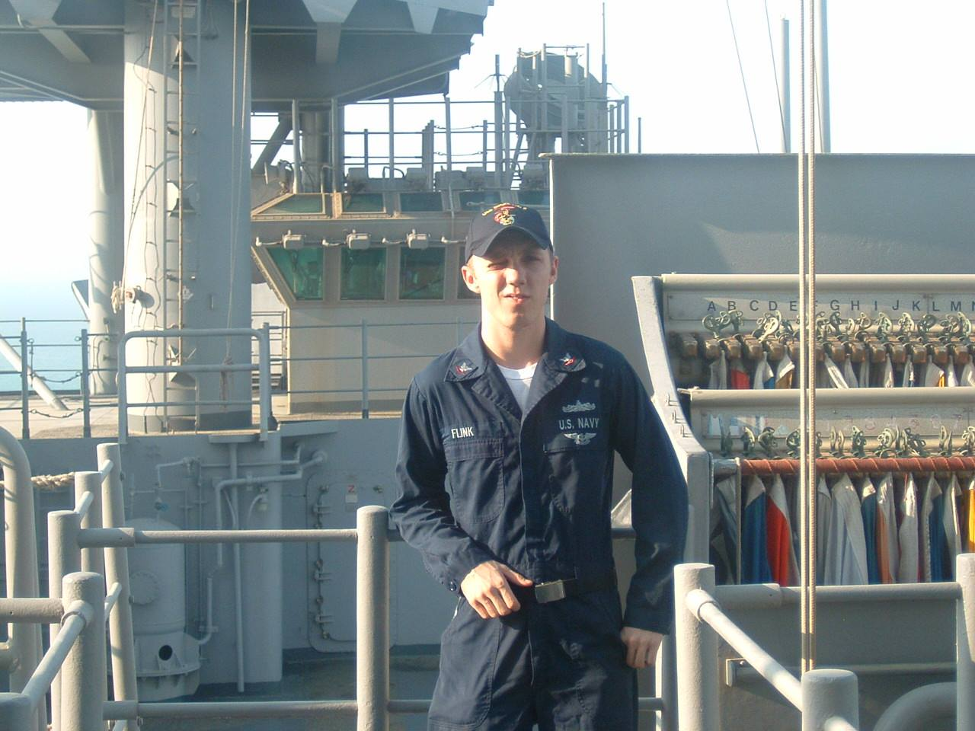
Veterans and Disability
Number of returning military with disabilities is rising due in part to improved medical procedures
Despite the US participating in an increasingly “faceless war”, service-related injuries and deaths continue

Slide 22
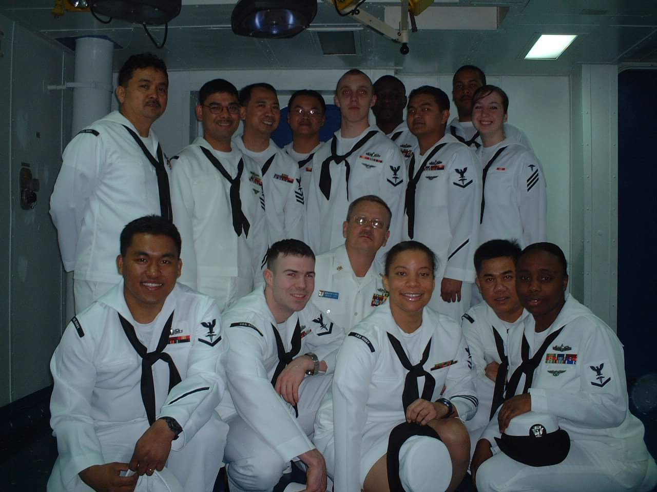
Invisible Disabilities
Invisible Disabilities:
Those disabilities which are not immediately apparent.
Examples:
Post-Traumatic Stress Disorder
Anxiety
Depression
Other Behavioral Disorders

Slide 23
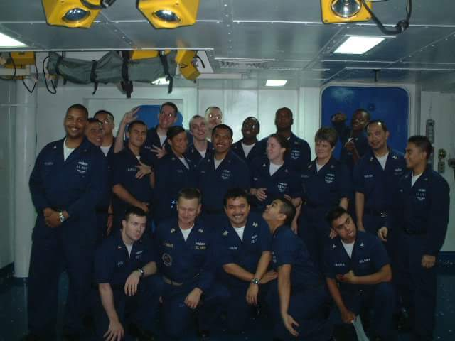
Stigma and Invisible Disabilities

Slide 24
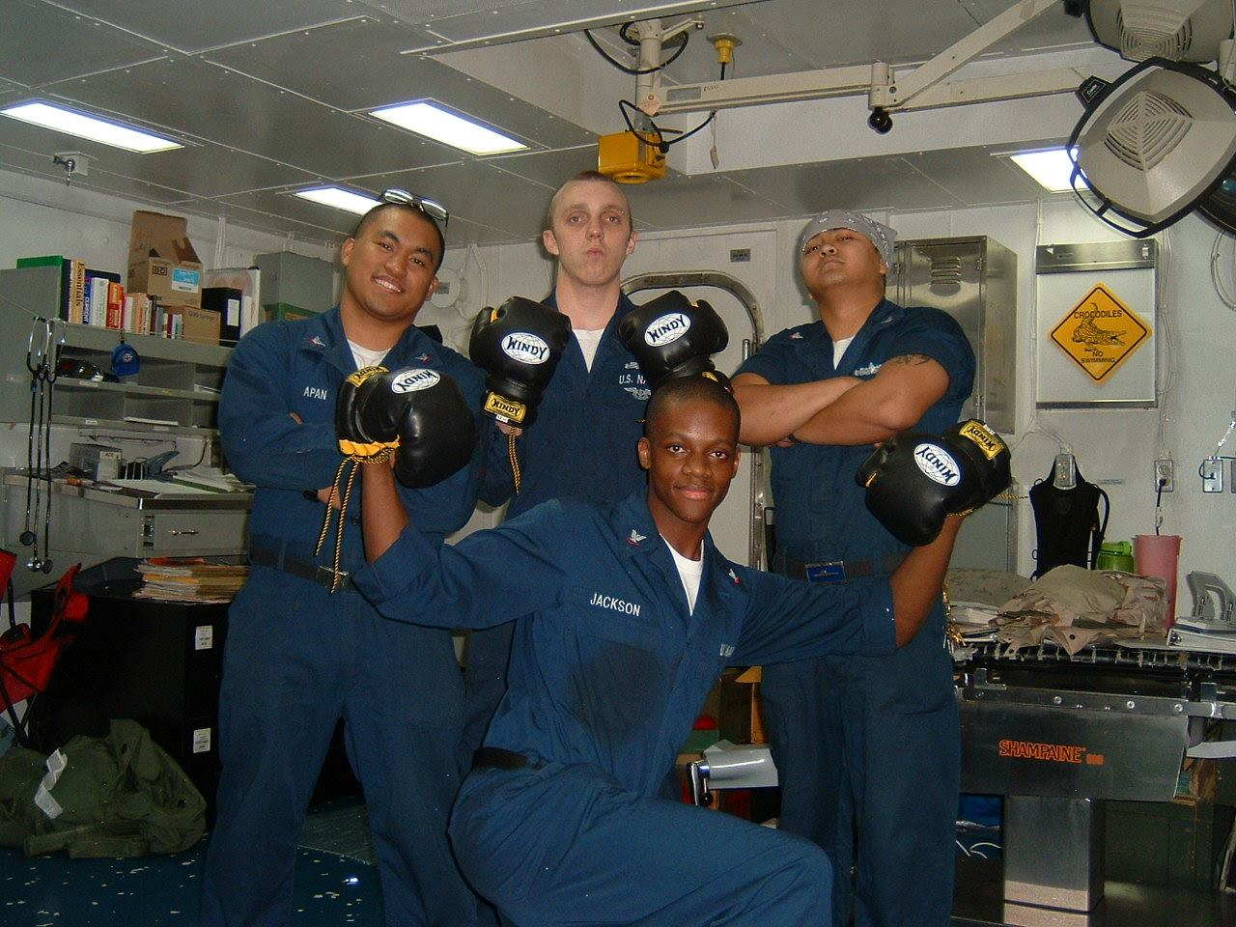
Stigma associated with being military
General Public’s Perceptions
Faculty Perceptions
Student Perceptions

Slide 25
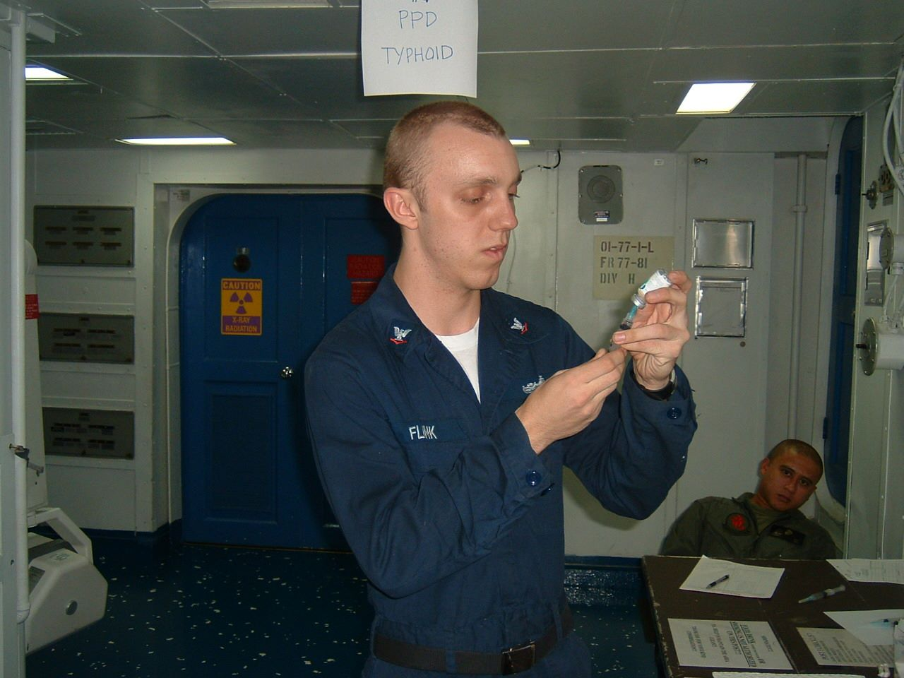
Stigmatization of military-related disabilities
The service-member:
Received injury or disability as a result of war activities
Is dangerous
Should be avoided
As a result, the service-member may:
Experience shame
Feel worthless
Feel like he or she doesn’t belong and withdraw from others
May internalize the public’s beliefs and fall victim to them
Experience exaggerated symptoms due to public’s beliefs

Slide 26
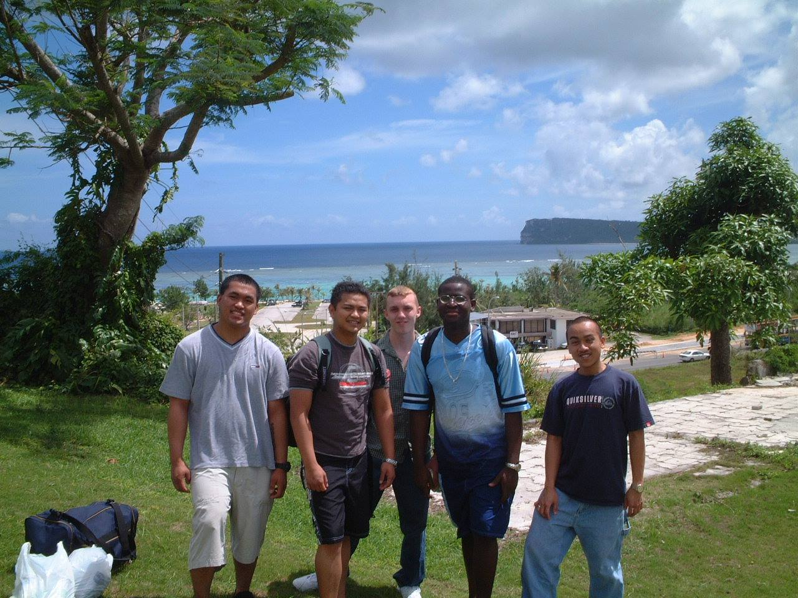
Transition to Higher Education
Putting it all together:
Transition from military life to civilian life

Slide 27
Transition to Higher Education
Putting it all together:
Transition from military life to civilian life
+
Having and living with a disability or disabilities

Slide 28
Transition to Higher Education
Putting it all together:
Transition from military life to civilian life
+
Having and living with a disability or disabilities
+
Experiencing stereotyping and discrimination

Slide 29
Transition to Higher Education
Putting it all together:
Transition from military life to civilian life
+
Having and living with a disability or disabilities
+
Experiencing stereotyping and discrimination
=
Challenging transition to being a civilian college student

Slide 30
Unique Experiences on Campus
Not feeling as if one fits in
Experiencing perceived or real discrimination, stereotyping, or mistreatment
Balancing disability-related issues with academic responsibilities
Having faculty or staff that may not be supportive

Slide 31
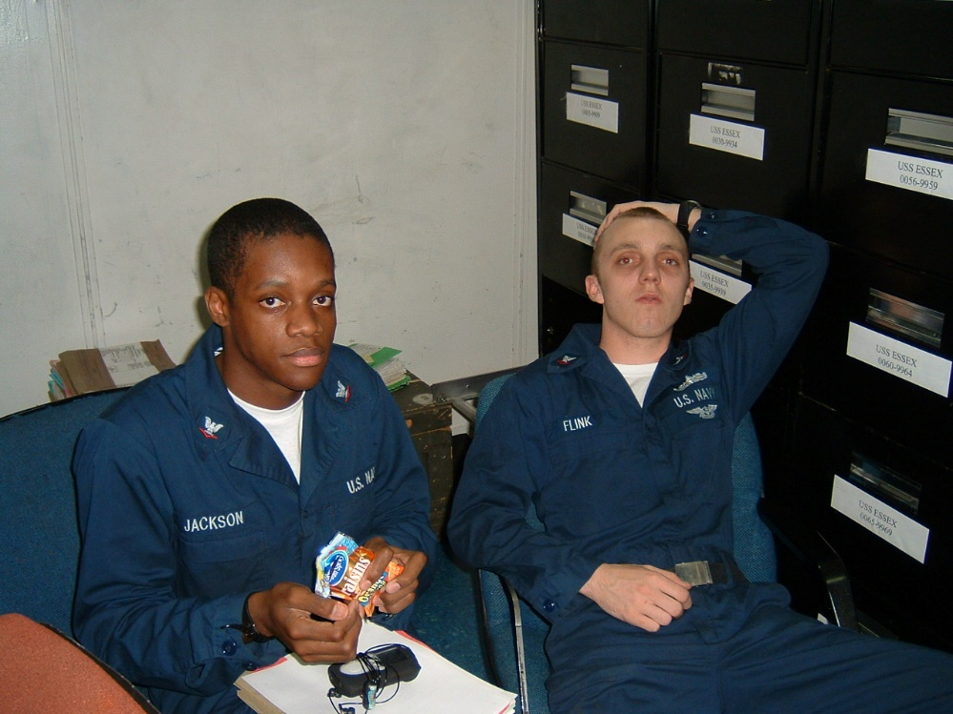
Looking Forward
“Nothing About Us Without Us”

Slide 32
Thank you!
To view my published (open access) article:
Flink, P. (2017). Invisible disabilities, stigma, and student veterans: Contextualizing the transition to higher education. Journal of Veterans Studies, 2(2), 1-10.
Patrick J. Flink, PhD
pflink@bmcc.cuny.edu / 212-220-1418
Borough of Manhattan Community College / CUNY School of Professional Studies

